Slide 1
BIOINFORMATICS UNIT AT LSCF
NGS-pipeline (for sandbox unit and INCPM)

Slide 2
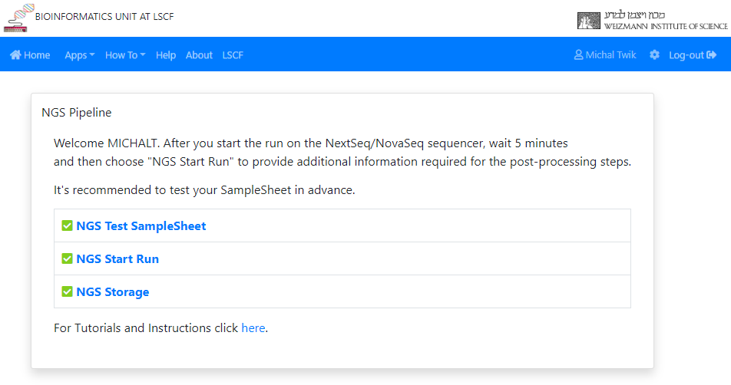
ngs-pipeline.weizmann.ac.il - Get post-sequencing services

Slide 3
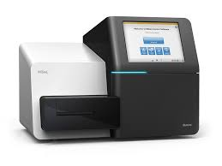
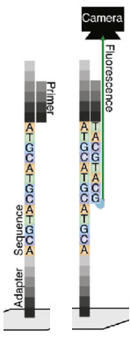
sequencing
Samples preparation
Input:
Flow cell is a glass slide containing small fluidic channels, through which polymerases, dNTPs and buffers can be pumped.
Sequencing
.bcl files
Genomics, Sandbox unit – Levine building
Output:
200806_NB501465_0649_AH3G37BGXG
Date_machineName_runNumber_flowCellCode
stefan.weizmann.ac.il
/data/nextseq
NextSeq machines
/data1/nextseq
/data1/novaseq
Genomics, INCPM unit - the Solar Tower building
mount of
igpfs.incpm.weizmann.ac.il
/genomics/NextSeq_runs
/genomics/NovaSeq_runs
NovaSeq/ NextSeq machines
Binary Base Call (BCL) files are the raw data files generated by the Illumina sequencers

Slide 4
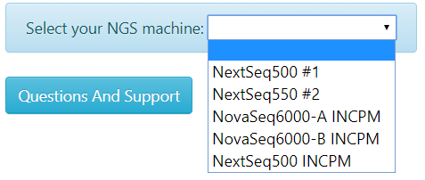
Register the run
ngs-pipeline.weizmann.ac.il
mg.weizmann.ac.il
Test the sample sheet
WEIZMANN LDAP
susanc3.weizmann.ac.il
LDAP
Protocols:
MARS-Seq
Next-Seq (trueSeq)
10X Genomics
stefan.weizmann.ac.il
/data/services/support/dat/runs/ Create yml file for each run
/data/fastq/ Create a folder for each run
/data/fastq/<run folder>/ Create xml for each step
Right after starting the run on the sequencer, wait 5 minutes.
Log in to the NGS Pipeline website using your SusanC3 user id
Select "NGS Start Run“
Select your sequencing machine
provide the IP userid
Upload a sample sheet according
to the protocol
HTTP request
RunBcl2Fastq
Cron
Run /data/services/support/sbin/updateStatus
Every 5 minutes
check the run
check the status of all the processes
in the xml files
RunFastQC
RunBlast
RunReport
Database
/data/services/support/dat/status.yml
RunDestrebution

Slide 5
The pipeline
RunBcl2Fastq
bcl2fastq software - converts BCL into FASTQ files
separates multiplexed samples (demultiplexing). The samples are identified by index sequences that were attached to the template during sample prep
The sample sheet (SampleSheet.csv/.xls file) directs the software how to assign reads to samples.
Generates a directory for each Sample, which contains all of the demultiplexed compressed FASTQ files
Reads with undetermined indices will be placed in the directory Undetermined
Stdout is written to this file: bcl2fastq.log. This file attached to the email if there was a problem
RunFastQC
RunBlast
RunReport
RunDistribution

Slide 6
The pipeline
FastQC tool - A quality control tool, providing a quick overview to tell you in which areas there may be problems
Run on each sample separately
Summary graphs and tables to quickly assess your data
Export of results to an HTML report for each sample
Run MultiQC software – join the samples and create an HTML for all the results.
Not applicable when running without a sample sheet (without demultiplexing)
RunBcl2Fastq
RunFastQC
RunBlast
RunReport
RunDistribution

Slide 7
The pipeline
RunBcl2Fastq
Run Blast on the table of “overrepresented sequences” in the fastqc report (of each sample) and find the possible source (organism) for this sequence.
The taxonomy DB is built by bioutils package of python
Not applicable when running without a sample sheet (without demultiplexing)
RunFastQC
RunBlast
RunReport
RunDistribution

Slide 8
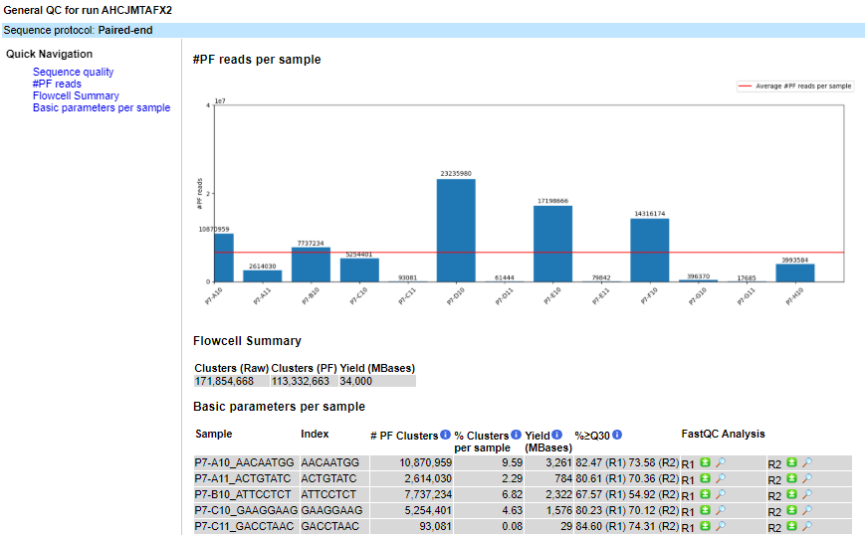
The pipeline
Create a report with:
An HTML with graphs for the run results statistics
Links to all FASTQC reports
Link to MultiQC report
RunBcl2Fastq
RunFastQC
RunBlast
RunReport
RunDistribution

Slide 9
The pipeline
RunBcl2Fastq
Create folders and links for each user and PI
An email will be sent upon sequencing completion, with instructions about downloading Bcl and/or Fastq files.
If demultiplexing was selected, an additional link for viewing QC results will be attached
In case of error in bcl2fastq, a log file will be attached
RunFastQC
RunBlast
RunReport
RunDistribution

Slide 10
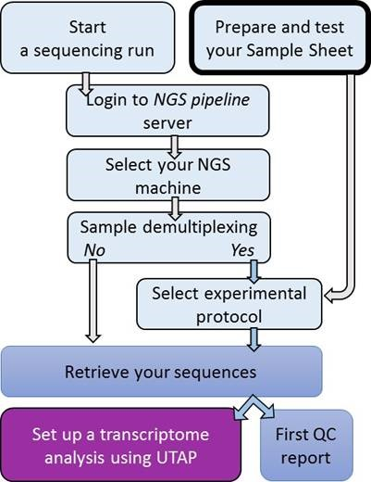
Summary

